Slide 1
ENEL 419 PROBABILITY AND RANDOM VARIABLES
Sequential Experiments and Principles of Counting
(Reading Exercises: Montgomery and Runger Chapter 2 - Sections 2.2 & Class notes)
(Reading Exercises: Yates and Goodman Chapter 2)

Slide 2
Applications
• The study of all possible arrangements of discrete objects,
• Algorithm complexity analysis,
• Resource allocation & scheduling (internet resources and frequency resources in digital communications etc.),
• Security analysis (assignment of IP and security codes, etc.)

Slide 3
Definition of Sequential Experiment
A sequential experiment is one that consists of a sequence of sub-experiments, where each subsequent sub-experiment is dependent on the previous.
Example: (1) toss a coin. (2) if a head shows up, then roll a die.

Slide 4
Examples of Sequential Experiments
Example 1: A property developer offers prospective home buyers a choice of 4 exterior styles: Tudor, Rustic, Colonial and Traditional. The developer also offers 3 floor plans, Ranch, Two-Storey and Split level.
This is a sequential experiment comprising 2 sub-experiments.
Sub-experiment 1: The selection of one exterior style (there are 4 ways to select).
Sub-experiment 2: The selection of one floor plan (there are 3 ways to select.

Slide 5
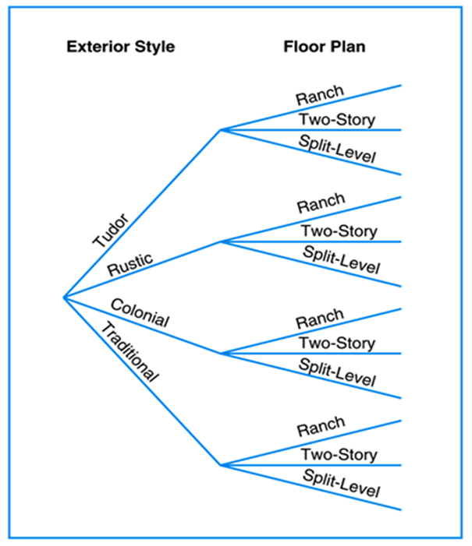
Sequential Experiment Example continued

Slide 6
Examples of Sequential Experiments
Assignment of offices to 10 people (sequential experiment). Assignment of one office to one person (sub-experiment)
Answering of 10 multiple choice questions (sequential experiment). Answering of one multiple choice question (sub-experiment)
Assigning unique passwords to 10 people (sequential experiment). Assigning a unique password to one individual (sub-experiment)

Slide 7
Counting Methods for Sequential Experiments
A sequential experiment usually produces several outcomes (events) that form a sample space. Evaluation of the probability of outcomes or events requires (1) the cardinality of the sample space and (2) the cardinality of the events. The probabilities are then determined using the classical method of assigning probabilities.
Definition:
A counting method is a systematic method used to count the cardinalities of the sample space and of the events in a sequential experiment.

Slide 8
Types of Counting Methods
The following is a list of counting methods most frequently used in engineering:
• Tree diagram
• Multiplication rule
• Permutations
• Combinations
• Distinguishable Permutations

Slide 9
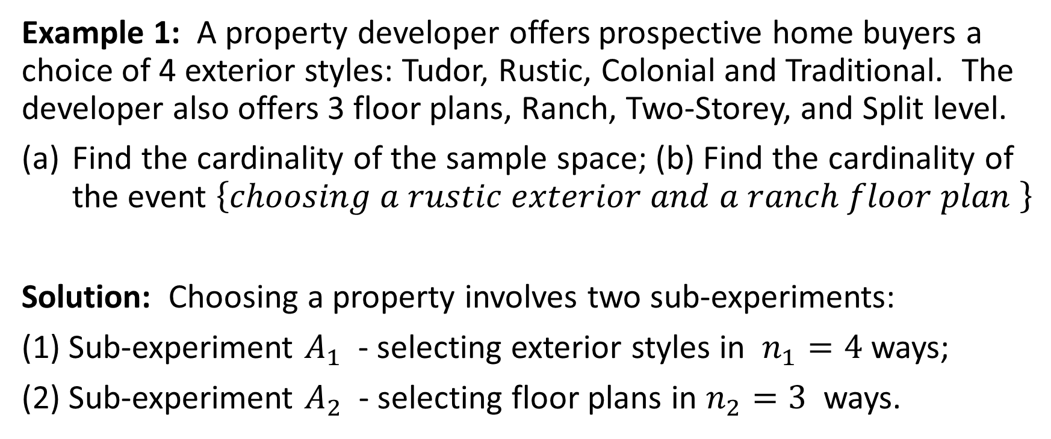
Tree Diagram
Example 1: A property developer offers prospective home buyers a choice of 4 exterior styles: Tudor, Rustic, Colonial and Traditional. The developer also offers 3 floor plans, Ranch, Two-Storey, and Split level.
Find the cardinality of the sample space; (b) Find the cardinality of the event $\left\{choosing a rustic exterior and a ranch floor plan \right\}$
Solution: Choosing a property involves two sub-experiments:
(1) Sub-experiment $A_{1}$ - selecting exterior styles in $n_{1}=4$ ways;
(2) Sub-experiment $A_{2}$ - selecting floor plans in $n_{2}=3$ ways.

Slide 10

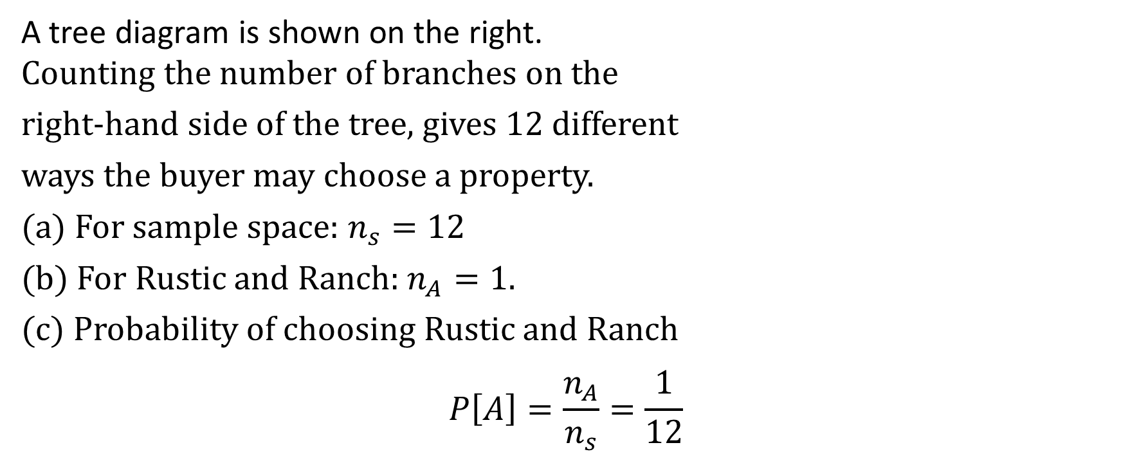
Tree Diagram for Selecting Property
A tree diagram is shown on the right.
Counting the number of branches on the
right-hand side of the tree, gives 12 different
ways the buyer may choose a property.
(a) For sample space: $n_{s}=12$
(b) For Rustic and Ranch: $n_{A}=1$.
(c) Probability of choosing Rustic and Ranch
$$P\left[A\right]=\frac{n_{A}}{n_{s}}=\frac{1}{12}$$

Slide 11
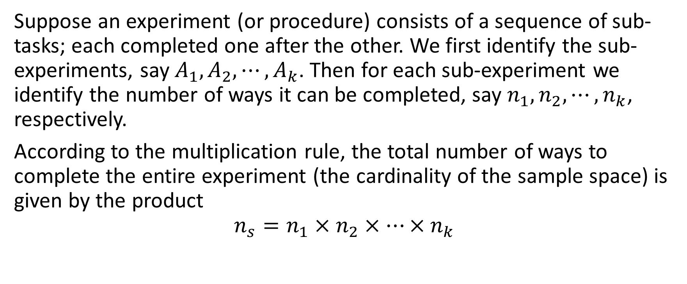
Multiplication Rule
Suppose an experiment (or procedure) consists of a sequence of sub-tasks; each completed one after the other. We first identify the sub-experiments, say $A_{1}, A_{2}, ⋯, A_{k}$. Then for each sub-experiment we identify the number of ways it can be completed, say $n_{1}, n_{2}, ⋯, n_{k}$, respectively.
According to the multiplication rule, the total number of ways to complete the entire experiment (the cardinality of the sample space) is given by the product
$$n_{s}=n_{1}×n_{2}×⋯×n_{k}$$

Slide 12
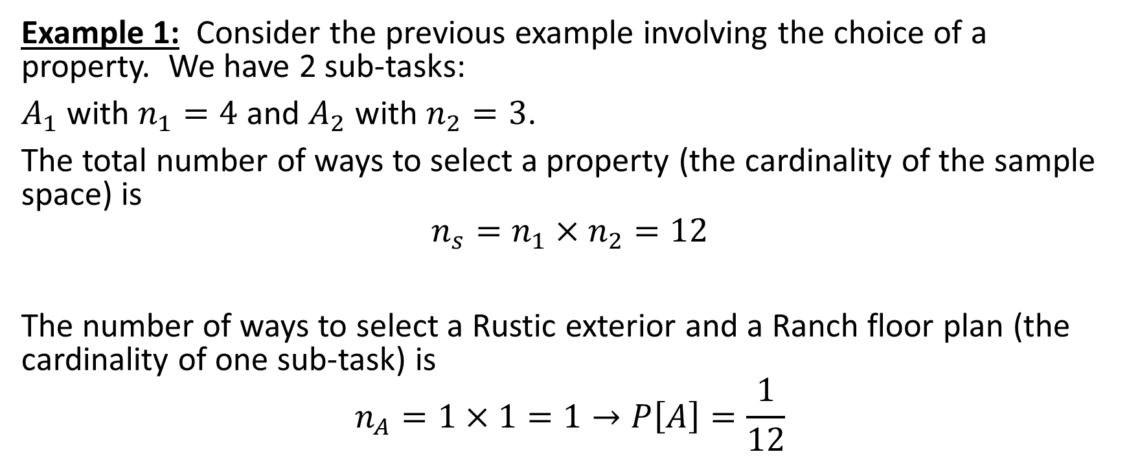
Multiplication Rule – Example 1
Example 1: Consider the previous example involving the choice of a property. We have 2 sub-tasks:
$A_{1}$ with $n_{1}=4$ and $A_{2}$ with $n_{2}=3$.
The total number of ways to select a property (the cardinality of the sample space) is
$$n_{s}=n_{1}×n_{2}=12$$
The number of ways to select a Rustic exterior and a Ranch floor plan (the cardinality of one sub-task) is
$$n_{A}=1×1=1→P\left[A\right]=\frac{1}{12}$$

Slide 13
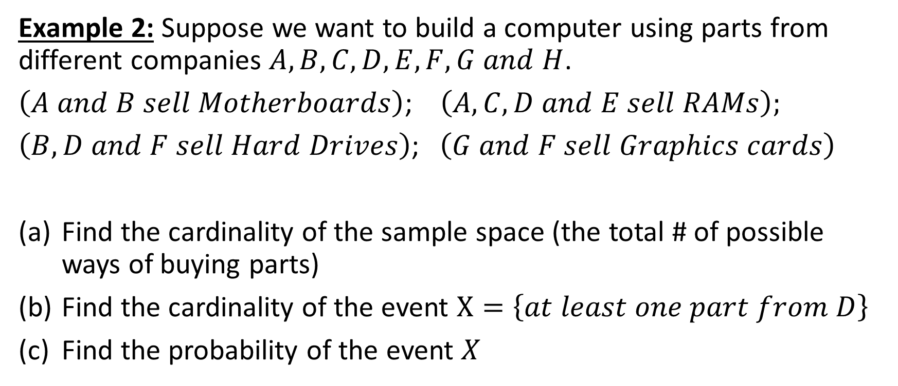
Multiplication Rule – Example 2
Example 2: Suppose we want to build a computer using parts from different companies $A, B, C, D, E, F, G and H$.
$\left(A and B sell Motherboards\right)$; $\left(A, C, D and E sell RAMs\right);$
$\left(B, D and F sell Hard Drives\right)$; $\left(G and F sell Graphics cards\right)$
Find the cardinality of the sample space (the total # of possible ways of buying parts)
Find the cardinality of the event $X=\left\{at least one part from D\right\}$
Find the probability of the event $X$

Slide 14
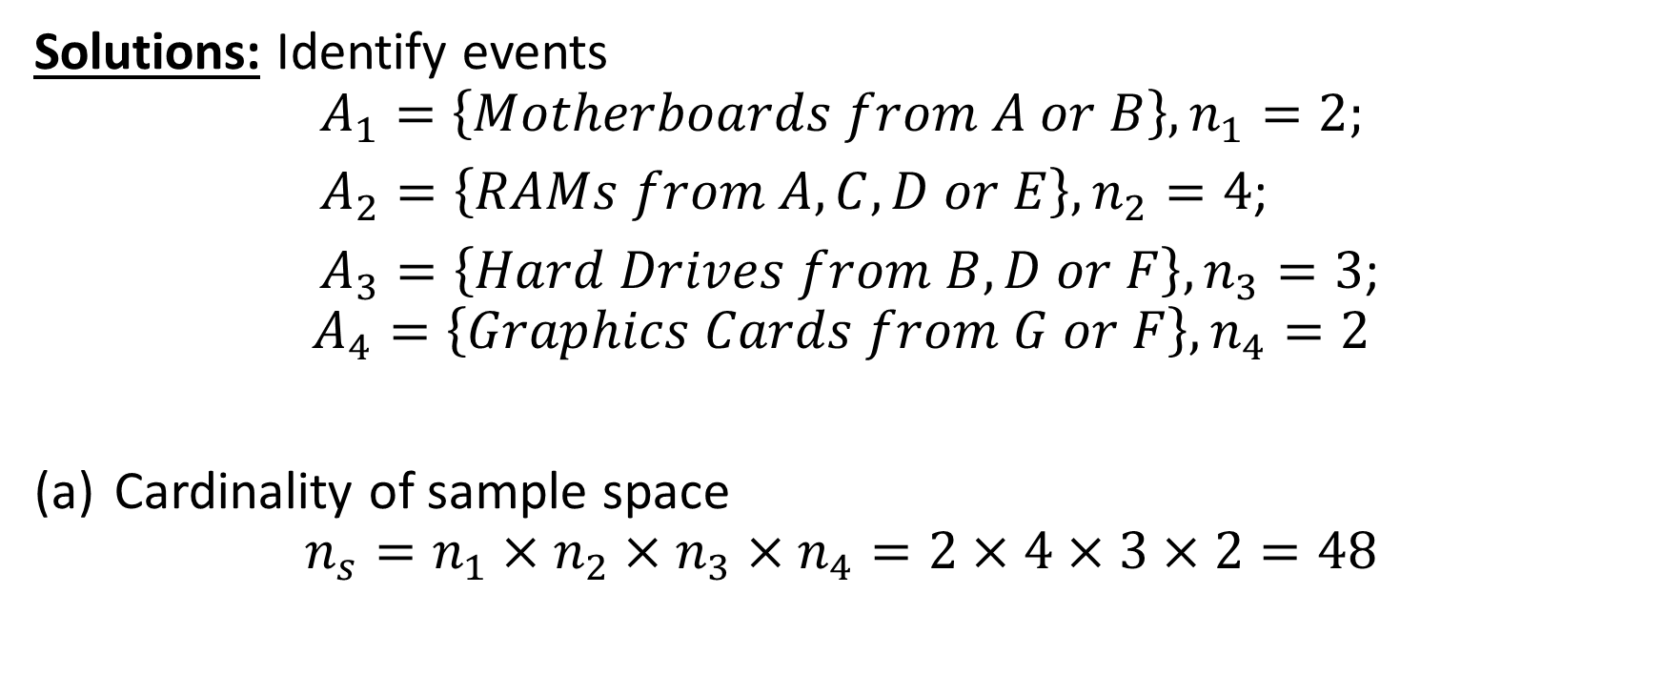
Multiplication Rule – Example 2 continued
Solutions: Identify events
$$A_{1}=\left\{Motherboards from A or B\right\}, n_{1}=2;$$
$A_{2}=\left\{RAMs from A, C, D or E\right\}, n_{2}=4$;
$A_{3}=\left\{Hard Drives from B, D or F\right\}, n_{3}=3$;
$$A_{4}=\left\{Graphics Cards from G or F\right\}, n_{4}=2$$
Cardinality of sample space
$$n_{s}=n_{1}×n_{2}×n_{3}×n_{4}=2×4×3×2=48$$

Slide 15
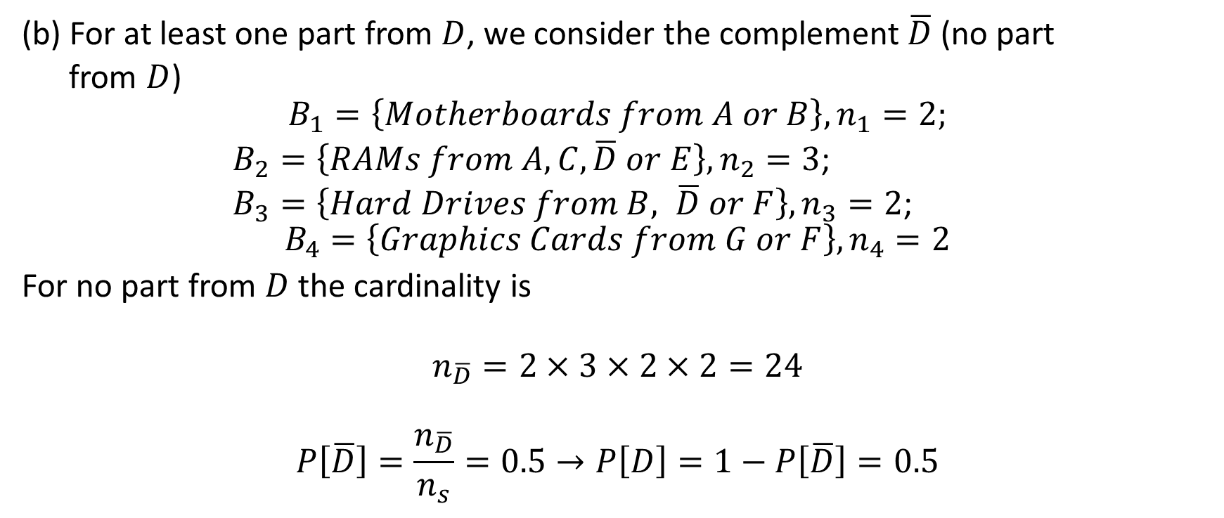
Multiplication Rule – Example 2 continued
(b) For at least one part from $D$, we consider the complement $\overline{D}$(no part
from $D$)
$$B_{1}=\left\{Motherboards from A or B\right\}, n_{1}=2;$$
$B_{2}=\left\{RAMs from A, C, \overline{D} or E\right\}, n_{2}=3$;
$B_{3}=\left\{Hard Drives from B, \overline{D} or F\right\}, n_{3}=2$;
$$B_{4}=\left\{Graphics Cards from G or F\right\}, n_{4}=2$$
For no part from $D$ the cardinality is
$$n_{\overline{D}}=2×3×2×2=24$$
$$P\left[\overline{D}\right]=\frac{n_{\overline{D}}}{n_{s}}=0.5→P\left[D\right]=1−P\left[\overline{D}\right]=0.5$$

Slide 16
Permutations
A permutation is the number of ordered arrangements of objects.
Consider the 2 objects colored green and purple below. There are 2 ways to arrange these objects, therefore, the permutation is 2
As the number of objects increase, it becomes more difficult to count the number of permutations
Rules of permutations: (1) order matters and (2) there is no duplications or repetitions (or replacements)

Slide 17
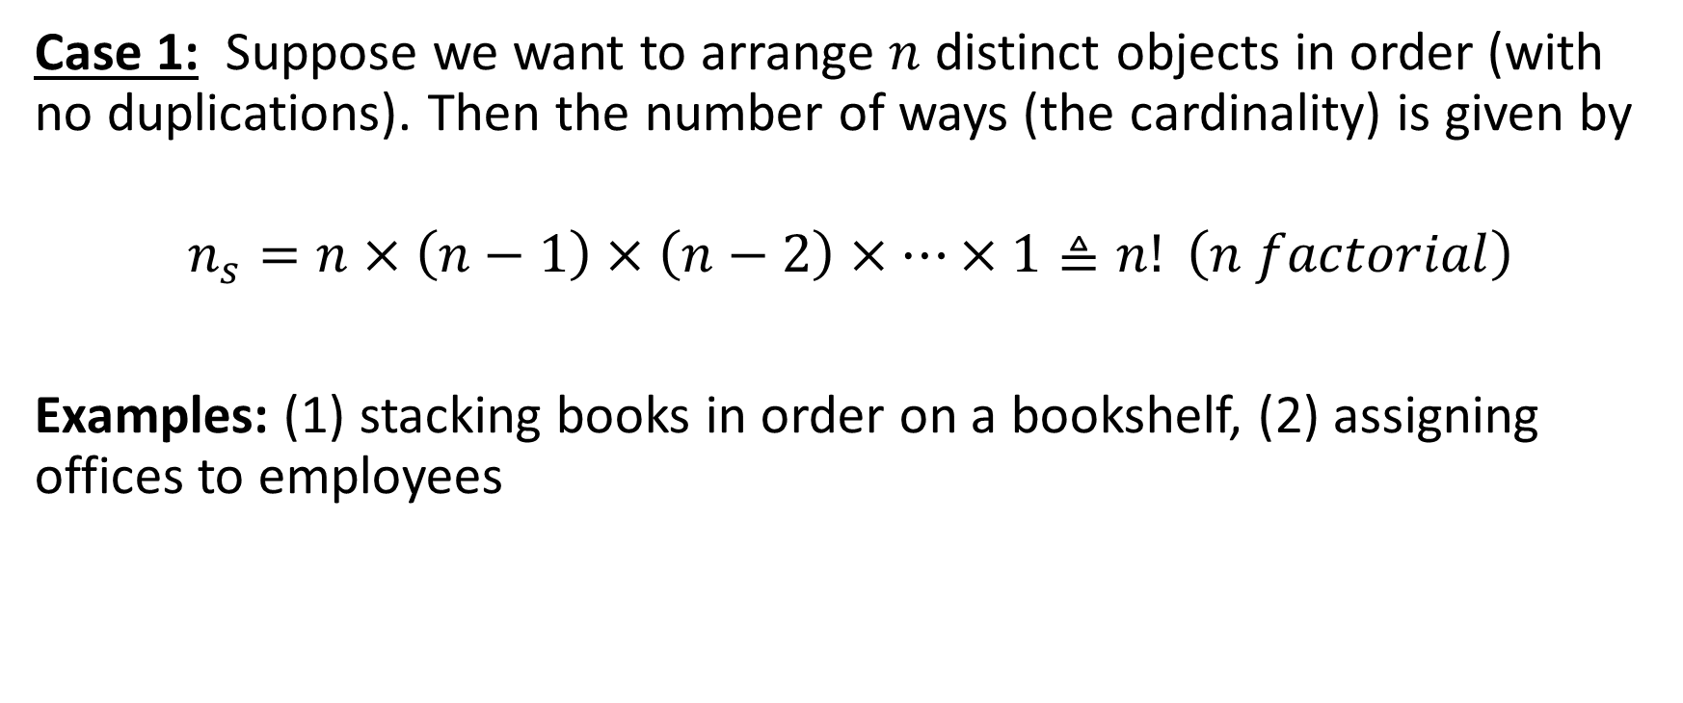
Permutations
Case 1: Suppose we want to arrange $n$ distinct objects in order (with no duplications). Then the number of ways (the cardinality) is given by
$$n_{s}=n×\left(n−1\right)×\left(n−2\right)×⋯×1≜n! \left(n factorial\right)$$
Examples: (1) stacking books in order on a bookshelf, (2) assigning offices to employees

Slide 18
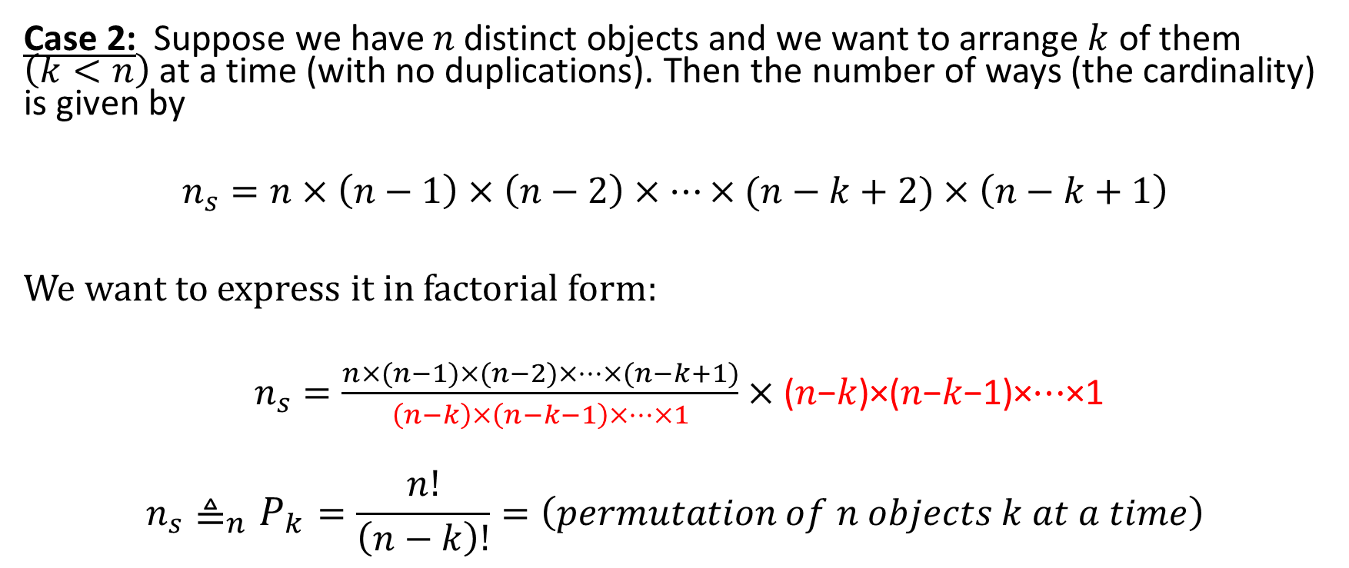
Permutations
Case 2: Suppose we have 𝑛 distinct objects and we want to arrange $k$ of them $\left(k<n\right)$ at a time (with no duplications). Then the number of ways (the cardinality) is given by
$$n_{s}=n×\left(n−1\right)×\left(n−2\right)×⋯×(n−k+2)×\left(n−k+1\right)$$
We want to express it in factorial form:
$n_{s}=\frac{n×(n−1)×(n−2)×⋯×(n−k+1)}{\left(n−k\right)×\left(n−k−1\right)×⋯×1}×\text{(}\text{n}\text{−}\text{k}\text{)×(}\text{n}\text{−}\text{k}\text{−1)×⋯×1}$
$$n_{s}{{\text{≜}}_{n}P}_{k}=\frac{n!}{\left(n−k\right)!}=\left(permutation of n objects k at a time\right)$$

Slide 19

Permutations
In general, permutation can be thought of as a process of placing $n$ objects into offices, positions or slots with $k \left(1≤k≤n\right)$ objects in each office, position or slot at a time. Repetition is not allowed because one person (or $k$ individuals) cannot occupy different rooms at the same time.

Slide 20
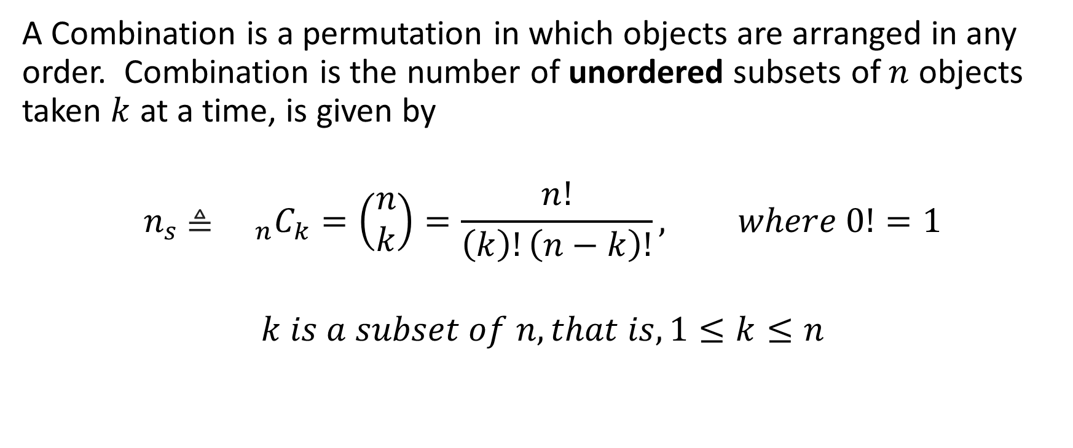
Combinations
A Combination is a permutation in which objects are arranged in any order. Combination is the number of unordered subsets of $n$ objects taken $k$ at a time, is given by
$$n_{s} \text{≜} {{}_{n}C}_{k}=\left(\begin{aligned}n \\ k\end{aligned}\right)=\frac{n!}{\left(k\right)!\left(n−k\right)!}, where 0!=1$$
$$k is a subset of n, that is, 1≤k≤n$$

Slide 21
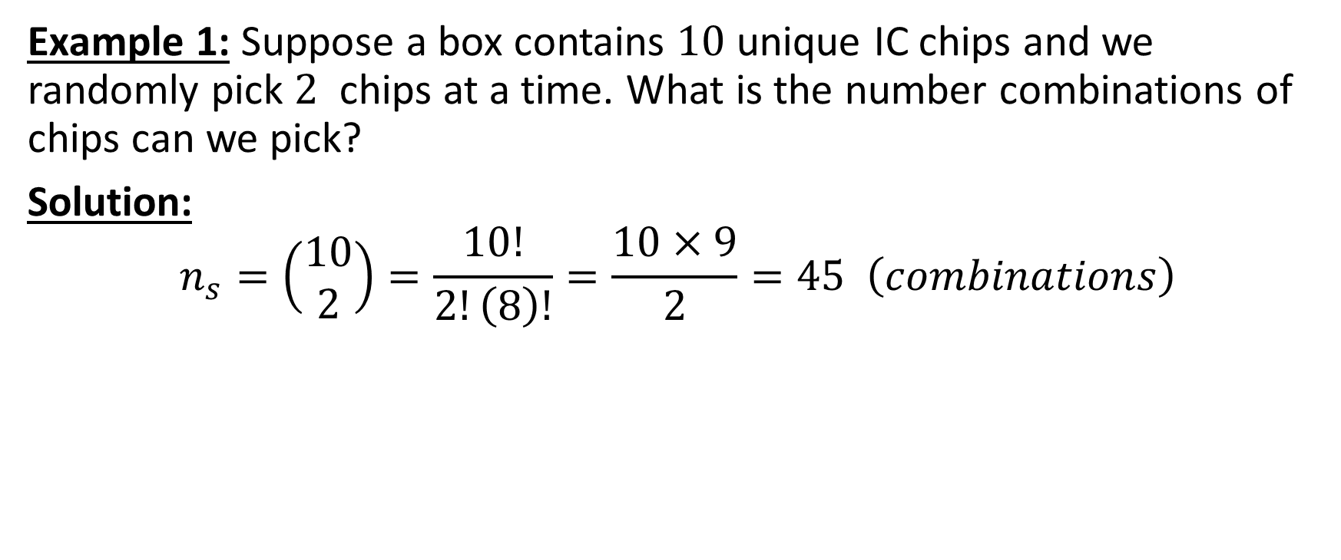
Combination Examples
Example 1: Suppose a box contains $10$ unique IC chips and we randomly pick $2$ chips at a time. What is the number combinations of chips can we pick?
Solution:
$$n_{s}=\left(\begin{aligned}10 \\ 2\end{aligned}\right)=\frac{10!}{2!\left(8\right)!}=\frac{10×9}{2}=45 \left(combinations\right)$$

Slide 22
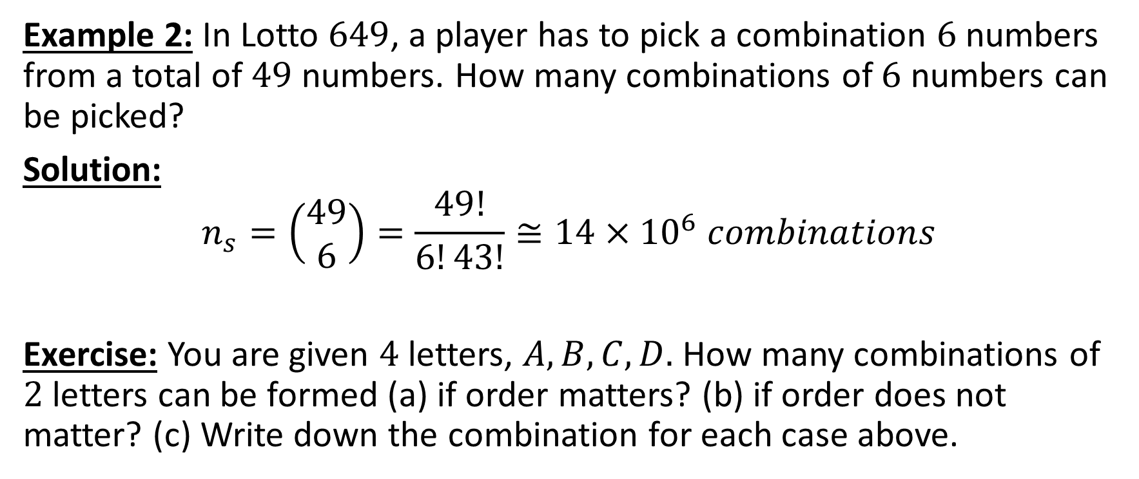
Combination Examples
Example 2: In Lotto $649$, a player has to pick a combination $6$ numbers from a total of $49$ numbers. How many combinations of $6$ numbers can be picked?
Solution:
$$n_{s}=\left(\begin{aligned}49 \\ 6\end{aligned}\right)=\frac{49!}{6!43!}≅14×{10}^{6} combinations$$
Exercise: You are given $4$ letters, $A,B,C,D.$ How many combinations of $2$ letters can be formed (a) if order matters? (b) if order does not matter? (c) Write down the combination for each case above.

Slide 23
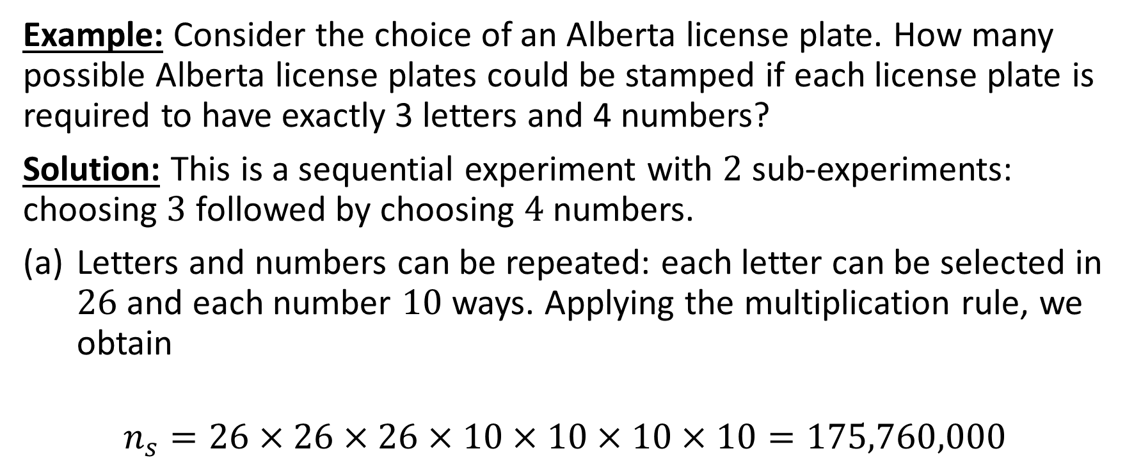
Multiplication and Permutation Rules for Sequential Experiments
Example: Consider the choice of an Alberta license plate. How many possible Alberta license plates could be stamped if each license plate is required to have exactly 3 letters and 4 numbers?
Solution: This is a sequential experiment with $2$ sub-experiments: choosing $3$ followed by choosing $4$ numbers.
Letters and numbers can be repeated: each letter can be selected in $26$ and each number $10$ ways. Applying the multiplication rule, we obtain
$$n_{s}=26×26×26×10×10×10×10=175,760,000$$

Slide 24
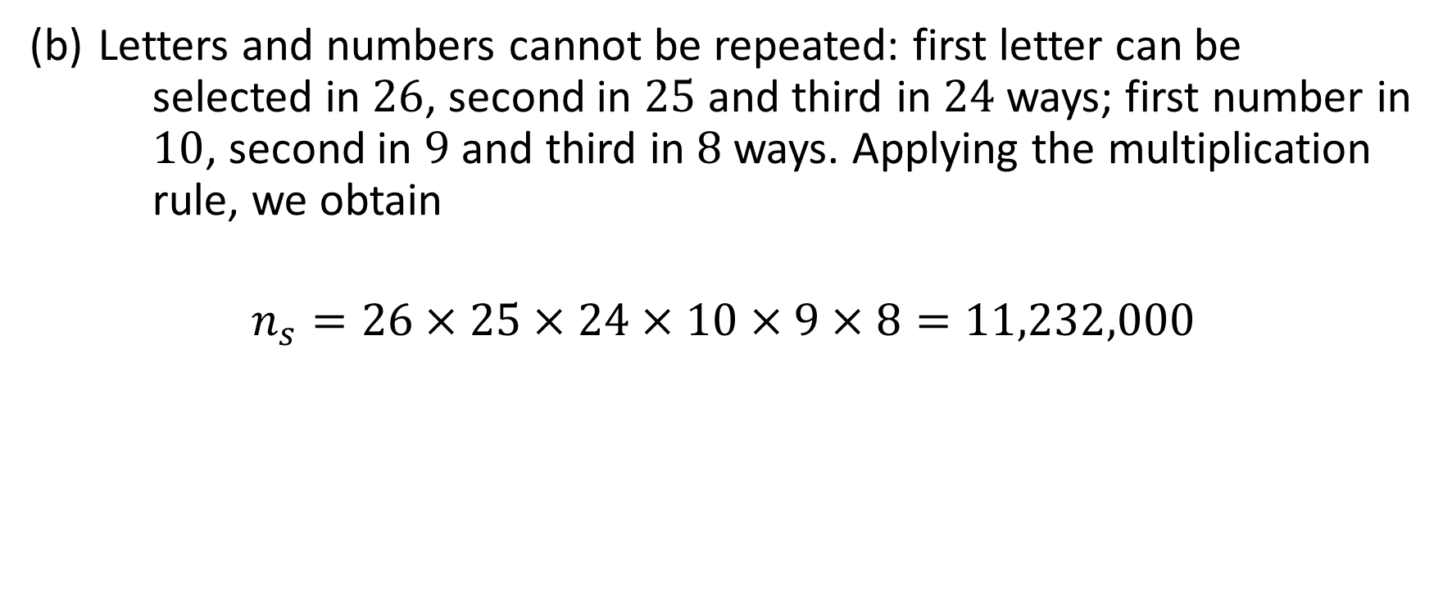
Multiplication and Permutation Rules for Sequential Experiments (continued)
Letters and numbers cannot be repeated: first letter can be selected in $26$, second in $25$ and third in $24$ways; first number in $10$, second in $9$ and third in $8$ ways. Applying the multiplication rule, we obtain
$$n_{s}=26×25×24×10×9×8=11,232,000$$

Slide 25
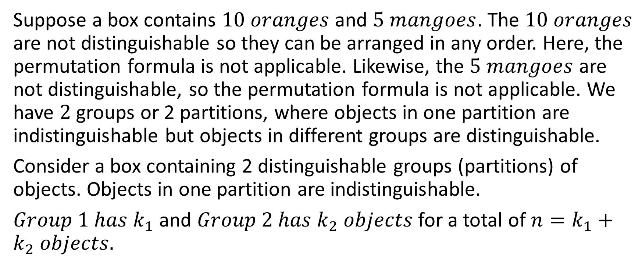
Distinguishable Permutations
Suppose a box contains $10 oranges$ and $5 mangoes$. The $10 oranges$ are not distinguishable so they can be arranged in any order. Here, the permutation formula is not applicable. Likewise, the $5 mangoes$ are not distinguishable, so the permutation formula is not applicable. We have $2$ groups or 2 partitions, where objects in one partition are indistinguishable but objects in different groups are distinguishable.
Consider a box containing 2 distinguishable groups (partitions) of objects. Objects in one partition are indistinguishable.
$Group 1 has k_{1}$ and $Group 2 has k_{2} objects$ for a total of $n=k_{1}+k_{2} objects.$

Slide 26
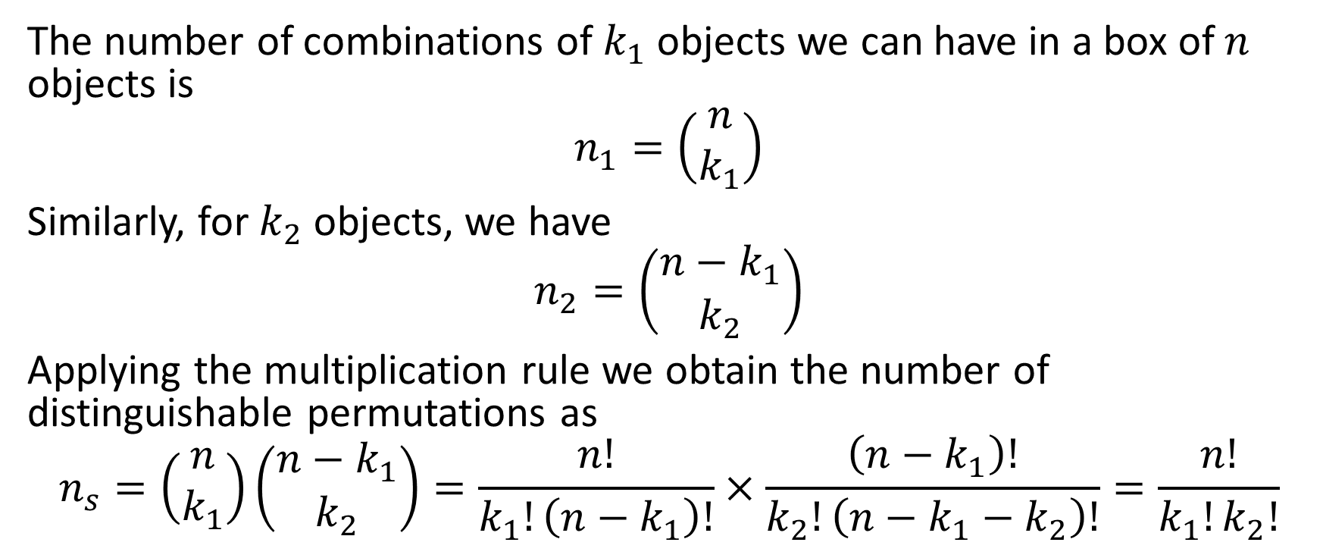
Distinguishable Permutations
The number of combinations of $k_{1}$ objects we can have in a box of $n$ objects is
$$n_{1}=\left(\begin{aligned}n \\ k_{1}\end{aligned}\right)$$
Similarly, for $k_{2}$ objects, we have
$$n_{2}=\left(\begin{aligned}n−k_{1} \\ k_{2}\end{aligned}\right)$$
Applying the multiplication rule we obtain the number of distinguishable permutations as
$$n_{s}=\left(\begin{aligned}n \\ k_{1}\end{aligned}\right)\left(\begin{aligned}n−k_{1} \\ k_{2}\end{aligned}\right)=\frac{n!}{k_{1}!\left(n−k_{1}\right)!}×\frac{\left(n−k_{1}\right)!}{k_{2}!\left(n−k_{1}−k_{2}\right)!}=\frac{n!}{k_{1}!k_{2}!}$$

Slide 27
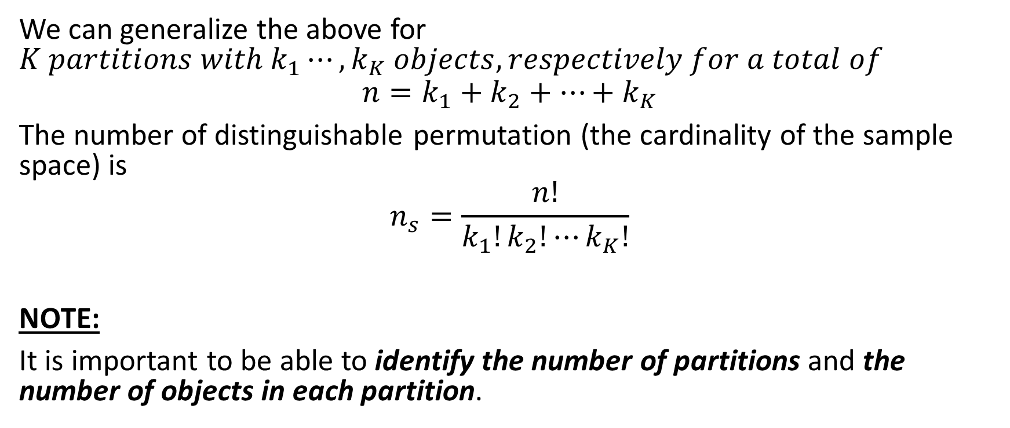
Distinguishable Permutations
We can generalize the above for $K partitions with k_{1}⋯,k_{K} objects, respectively for a total of$
$$n=k_{1}+k_{2}+⋯+k_{K}$$
The number of distinguishable permutation (the cardinality of the sample space) is
$$n_{s}=\frac{n!}{k_{1}!k_{2}!⋯k_{K}!}$$
NOTE:
It is important to be able to identify the number of partitions and the number of objects in each partition.

Slide 28
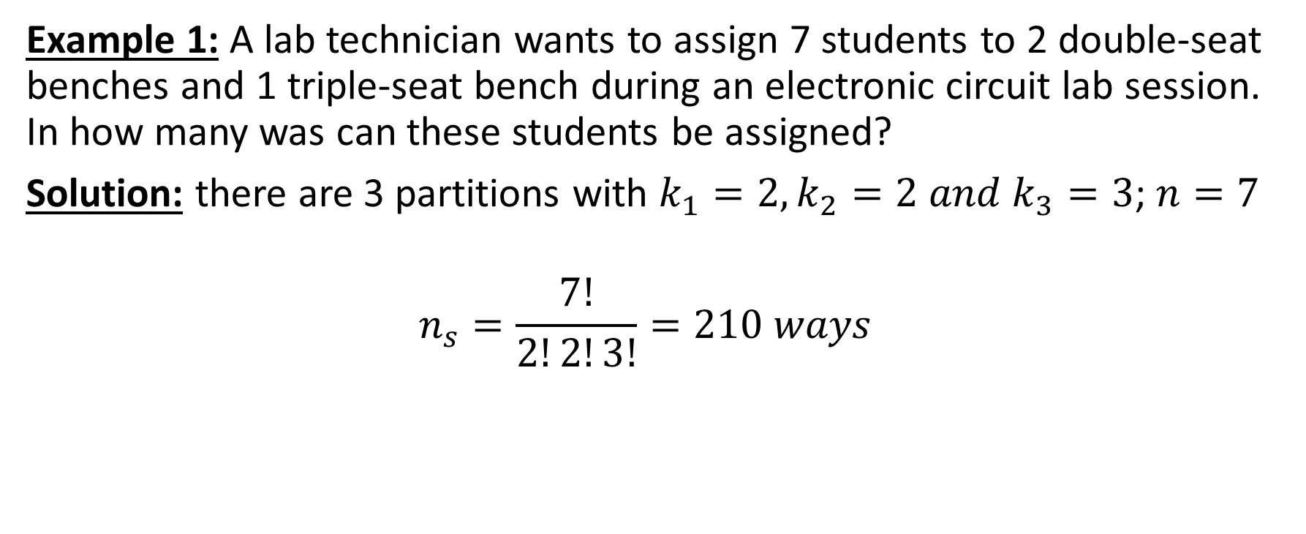
Distinguishable Permutation Examples
Example 1: A lab technician wants to assign 7 students to 2 double-seat benches and 1 triple-seat bench during an electronic circuit lab session. In how many was can these students be assigned?
Solution: there are 3 partitions with $k_{1}=2, k_{2}=2 and k_{3}=3$; $n=7$
$$n_{s}=\frac{7!}{2!2!3!}=210 ways$$

Slide 29
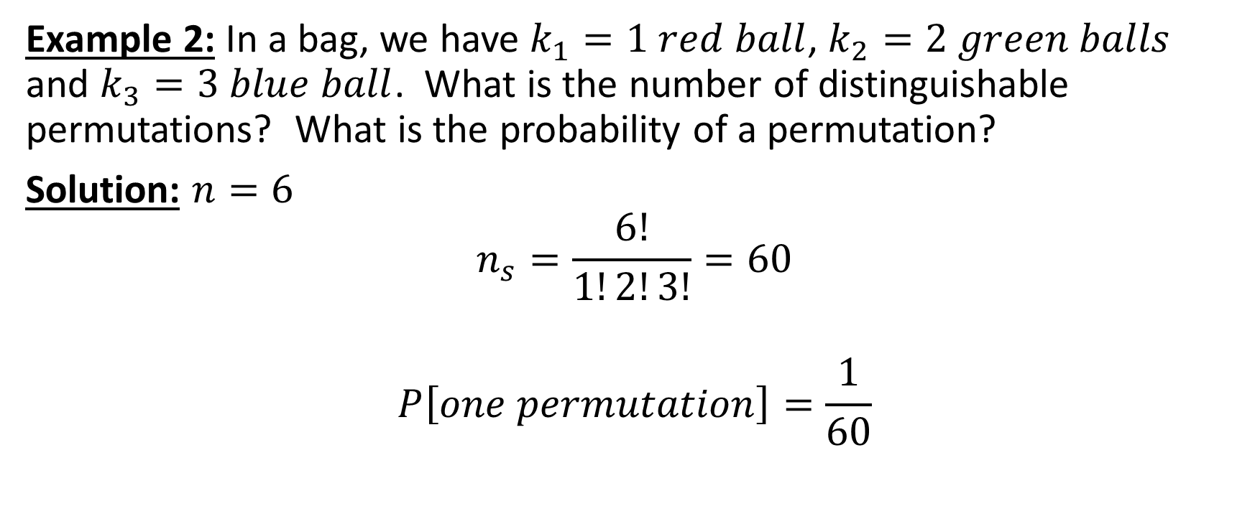
Distinguishable Permutation Examples
Example 2: In a bag, we have $k_{1}=1 red ball$, $k_{2}=2 green balls$ and $k_{3}=3 blue ball$. What is the number of distinguishable permutations? What is the probability of a permutation?
Solution: $n=6$
$$n_{s}=\frac{6!}{1!2!3!}=60$$
$$P\left[one permutation\right]=\frac{1}{60}$$

Slide 30
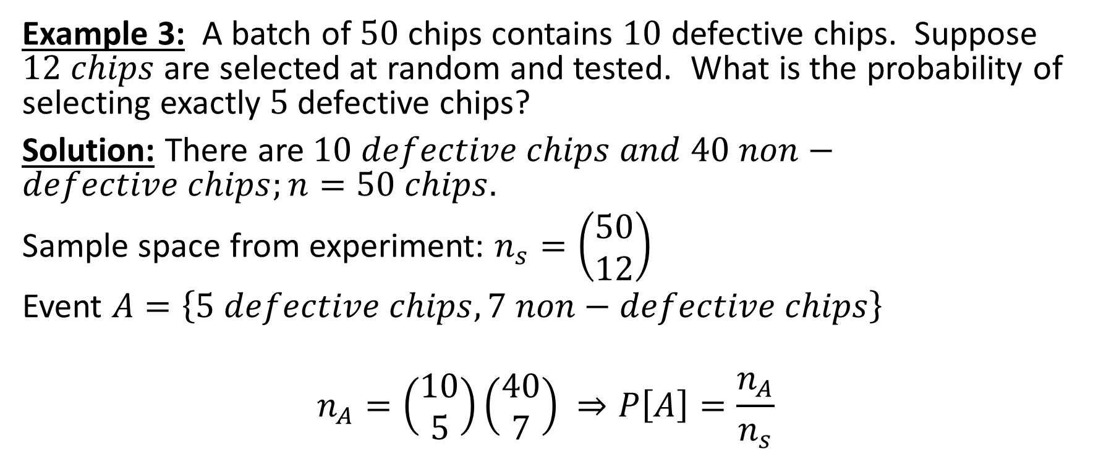
Distinguishable Permutation Examples
Example 3: A batch of $50$ chips contains $10$ defective chips. Suppose $12 chips$ are selected at random and tested. What is the probability of selecting exactly $5$ defective chips?
Solution: There are $10 defective chips and$ $40 non−defective chips;n=50 chips.$
Sample space from experiment: $n_{s}=\left(\begin{aligned}50 \\ 12\end{aligned}\right)$
Event $A=\left\{5 defective chips, 7 non−defective chips\right\}$
$$n_{A}=\left(\begin{aligned}10 \\ 5\end{aligned}\right)\left(\begin{aligned}40 \\ 7\end{aligned}\right) ⇒P\left[A\right]=\frac{n_{A}}{n_{s}}$$

Slide 31
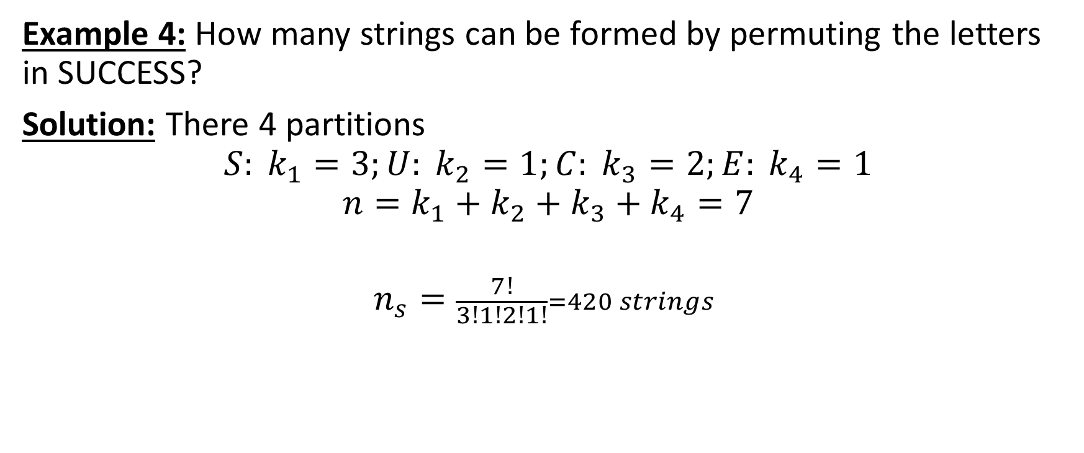
Distinguishable Permutation Examples
Example 4: How many strings can be formed by permuting the letters in SUCCESS?
Solution: There 4 partitions
$$S: k_{1}=3;U: k_{2}=1;C: k_{3}=2;E: k_{4}=1$$
$$n=k_{1}+k_{2}+k_{3}+k_{4}=7$$
$$n_{s}=\frac{7!}{3!1!2!1!}=420 strings$$

Slide 32
Concluding Remarks on Permutation and Combinations:
When to use Permutation or Combination:
• Use Permutation if order is important.
• Use combination if order is not important.
• When distinguishable partitions are involved.
Use combination for each partition and then apply the multiplication rule.

